Slide 1
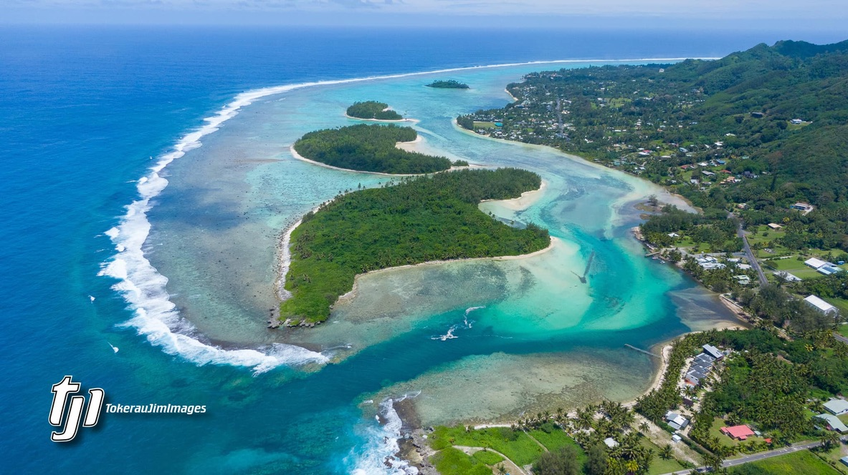
Muri Environment Care Society Global Environment Facility Small Grant Project – (UNOPS OP7) ECOLOGY STREAMS WATERWAYS & LAGOON

Slide 2
MEC Society our Objectives MEC Vision & Mission Our vision is of a sustainable Muri environment through the power of the community. Our mission is to guide, promote, network and carry out without prejudice all necessary actions to achieve its vision. MEC Objectives The Society is established for the purpose to provide the direction, guidance, information and create public awareness amongst the community in Muri and beyond regarding environmental, economic, social, cultural and religious issues To promote sound ideas, principles and practice for the purpose of conservation and sustainable development in the community while maintaining traditional Cook Islands maori knowledge and practices which are considered beneficial To promote the aspirations and enhance the balance and harmony between people in the community and the environment To cooperate and network with the similar organisations within the Cook Islands and beyond for the purpose of enhancing the cause of environmental conservation and sustainable development To carry out the actions to strengthen its capabilities, institutional arrangements and financial support to enable its work programs
MEC LOGO

Slide 3
The Muri Environment is the focus of our Ecology Project The topography of the Muri district is unique & complex. The Muri environment extends east to west from outer reefs & Pacific Ocean, to mountain peaks of Te Rua Manga and north to south from Vaikai Tapere, Avana Valley & Stream, Ngatangiia Harbour through 6 Tapere to Tikioki Tapere, to the Akapuao Stream & Fruits of Rarotonga. Within this 1.75km reef to ridge hinterland x 3.5km coastline is Ngatangiia harbour; Muri / Tikioki lagoons; 4 motus; 250+ residential homes; 30+ growers agricultural lands; extensive sandy beaches; 50+ commercial accommodation & Villa style tourism complexes; low hills rising to peaks of our mountains; streams, wetlands, waterways, and rivers. And in our wet-season, waterfalls & flood waters head down our valleys, across our wetlands turning streams, waterways & lagoons into extensive floodland leaving our lagoons with soil sediment & nutrient loads.
MEC LOGO

Slide 4
Vegetated riparian corridors are key to the healthy functioning of streams. We have proposed a riparian corridor planting process that is guided by landowners and inspired by local knowledge and scientific literature. This project will blend the best practices of riparian restoration from around the world with traditional ecological understanding to create consensus around what healthy streams look like in Rarotonga We recommend a diversity of interventions with a strong focus on observation in order to gauge the success of the agreed-upon planting process. With this menu of potential pilots, the plantings can match the landowner’s visions for the future with our riparian science. We aim to establish a mix of locally desired plants that have a robust, diverse, and complex network of roots that together work towards - Stabilising stream banks, Planting stream beds, Reducing the flow velocity, Filtering sediment & nutrient loads and Increasing native wildlife habitat
MEC LOGO

Slide 5
PILOT # 1: ECOSYSTEM ENGINEER SPECIES TRIALS Some plants are more valuable for riparian restoration in Rarotonga than others, especially among the resilient pioneer species. Criteria for the trees based on being able to grow fast, high tolerance to heavy pruning, thrive in less-than-ideal soil and potentially have multiple uses (root growth, edible fruit, shade & conservation value). Riparian restoration species we have dubbed “Ecosystem Engineers” to accelerate the return of key ecosystem functions. Over time, species will act as ‘nurse’ or support species to the increasingly complex and desirable suite of species. Note the appendix of species selected for having exceptional ability to alter their surrounding environments in ways that benefit riparian restoration.
MEC LOGO

Slide 6
PILOT # 2: OBSERVATION-FOCUSED PASSIVE RESTORATION An ‘observation-first’ approach with minimal interventions natural regeneration of sections of stream will give us numerous valuable insights. These areas are our ‘control’ plots that show what a hands-off approach to stream restoration would look like. Allowing streams to regenerate give us important insights in working with and make changes to enhance naturally occurring ecosystem recovery. Alongside passive restoration, we experiment with selective weeding, plantings fertilization, mulch mats and tree guards, sheet mulching and restoration techniques that have minimal disturbance on naturally regenerating plant communities. A focus on learning and observation in these areas.
MEC LOGO

Slide 7
MEC LOGO
PILOT # 3: RETURNING NATIVES TO RAROTONGA’S STREAMS
Many plants and trees common in the mountains will reestablish in the lowlands only with assistance and care from trained nursery people.
In 2021, MEC sourced seed of native trees from the Takitumu Conservation Area. We currently have seeds sown and germinating for target species. We grow and care for them in a nursery setting & gain insights on their feasibility/difficulty as a species to reintroduce in riparian corridors.
Streams come from the forested interior and riparian plantings act as habitat corridors, expanding the ranges of native species. These are most suited to the climate and geology in which they evolved providing for long term resilience.
We support all nurseries to grow native plants as we add to the Pa Ariki Takitumu native plant nursery for future
riparian restoration.

Slide 8
PILOT # 4: SWALES ON CONTOUR With earthworks, we will be able to capture and store water to 1) slow and the capture the runoff of water across residential and agricultural lands and 2) achieve better growth rates from water storage in the soil. Fast-moving water in heavy rain events carries a load high in nutrient and fine sediments, like precious organic matter. Incorporated into the soil, organic matter an essential ingredient and the best indicators of overall soil health. Fine sediments and organic matter wreak havoc on marine life once introduced into the lagoon. Swales encourage water to penetrate deep into the soil and are a means of slowing water down before contributing to increase volumes and velocity in the streams. By digging a level trench on contour, mounding the excavated soil downhill and then planting trees and over-vigorous rooting plants, we will delay a large quantity of water from entering a stream alongside the rest of the quickly running off water. Swales are a valuable tool to retain and distribute rainfall higher in the catchments.
MEC LOGO

Slide 9
PILOT RESULTS: These Riparian Pilots build consensus around local best practice stream restoration. We develop the pilot program alongside landowners, schools and interested community members. We develop pioneer species for disturbance revegetation and evaluate them on a site-by-site basis. Our surveys determine the current state of Muri village streams, includes vegetation, invertebrate species & low-impact, low-cost solutions to problems we identify. We are collecting seeds of native plant species in our Nursery to experiment riparian revegetation settings. The nursery produce and plant 2,000+ native plants from at least 5 species before the end of 2022. We learn more about local hydrology and test small scale water retention and detention schemes. We get results from 4 test plots testing the merits of swales on contour. We build an education program that allows for certificates and rewards for long-term participants. By the end of 2023, we will have high digital engagement from a local community well informed of our Pilots and their goals.
MEC LOGO

Slide 10
Implementation plan Muri Tapere Maai, Vaai, Aremango, Areiti, Oroko, Avana
MEC LOGO

Slide 11
MEC’s Partners The Landowners, Aronga Mana & Resident Communities Government Ministries, Crown Agencies, NGO’s & CSO’s Co-financiers, Sponsors & Volunteers Global Environment Facility – UNOP7 Small Grant Fund
MEC LOGO

Slide 12
IDENTIFIED AREAS OF CONCERN…….
SOLUTIONS are part of this PROJECTS WORK PLAN…….
ALGAE GROWTH IN MURI LAGOON AND SEDIMENTATION FROM ERODED STREAMS
BEACH EROSION - RISING SEA LEVELS
FLOOD CULVERT EROSION AND SEDIMENTATION – loss of Aroko habitat for koiti and other crabs - loss of seagrass nursery for fish and crustacean species
CLIMATE CHANGE IMPACTS – both surface water & underground reserves are disturbing global trends
RESEARCH, COLLECT, DISCUSS RELEVANT DATA AND SOLUTIONS FOR COMMUNITY EDUCATION
PUBLISH AND DISPERSE FACTS THROUGH THE COMMUNITY WITH POSTERS/FLYERS, WORKSHOPS, FACEBOOK & OUR WEBSITE
WORK WITH LANDOWNERS, RESIDENTS, ALL MINISTRIES, NGO’S & CSO’S TO ENGAGE IN REMEDIATION
WORK WITH COMMUNITY ORGANISATIONS & VILLAGE IN PRACTICAL PLANNING, PLANTING AND MAINTENANCE PROGRAM

Slide 13
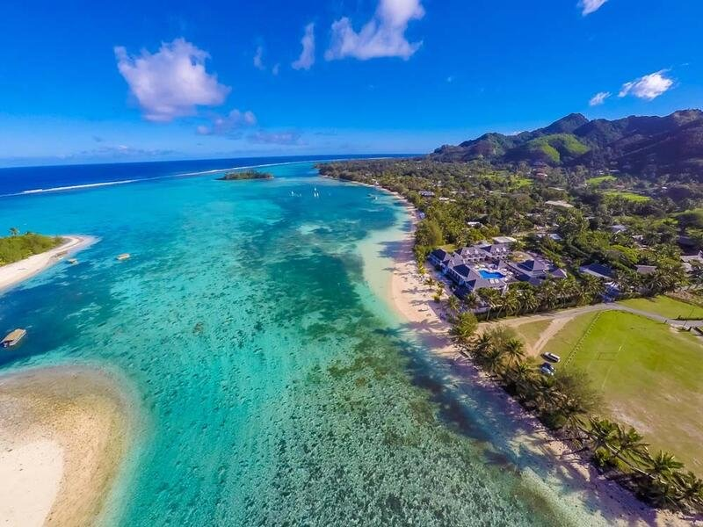
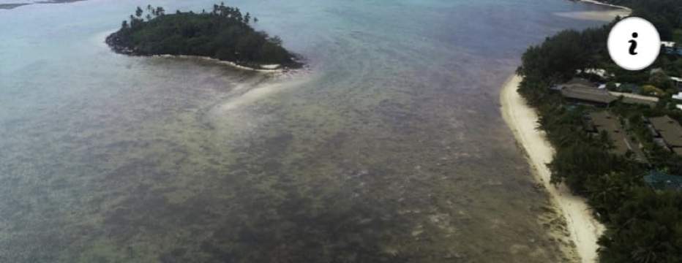
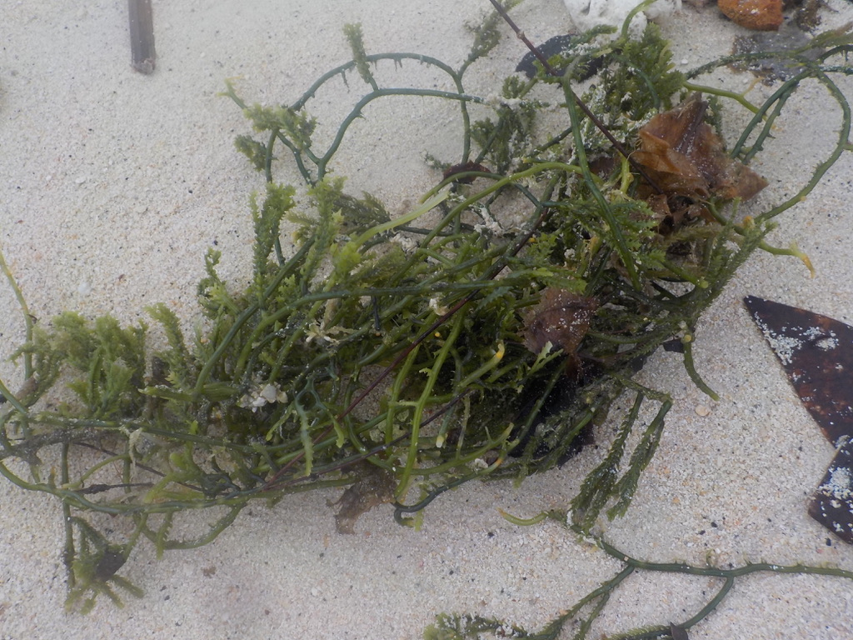
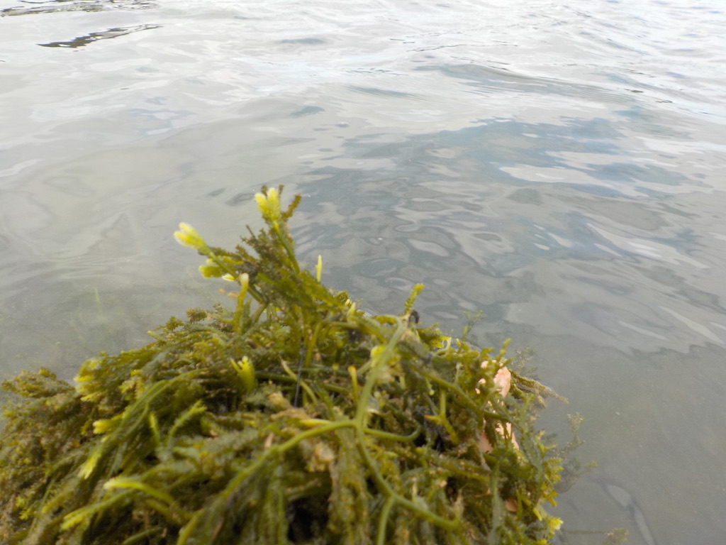
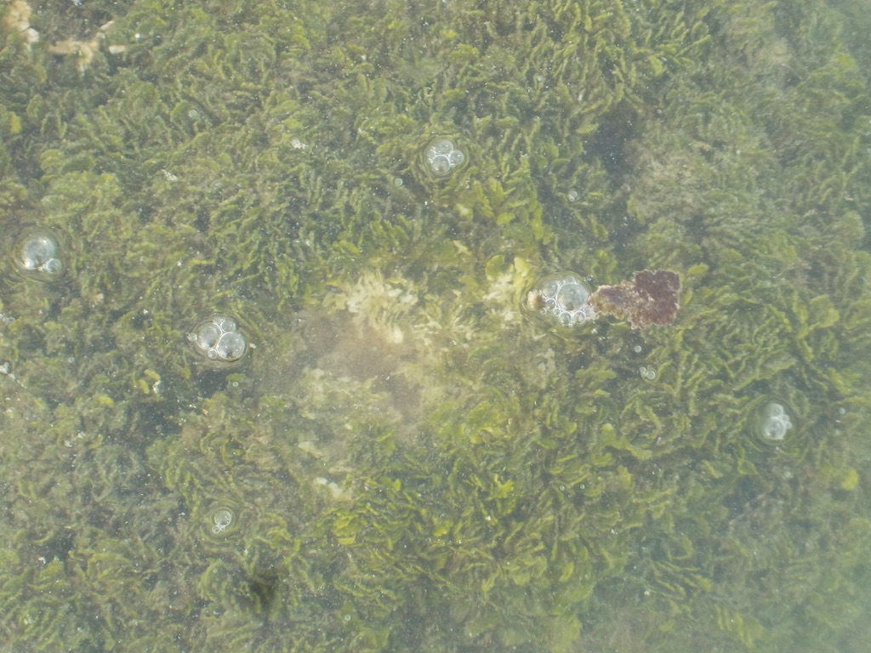
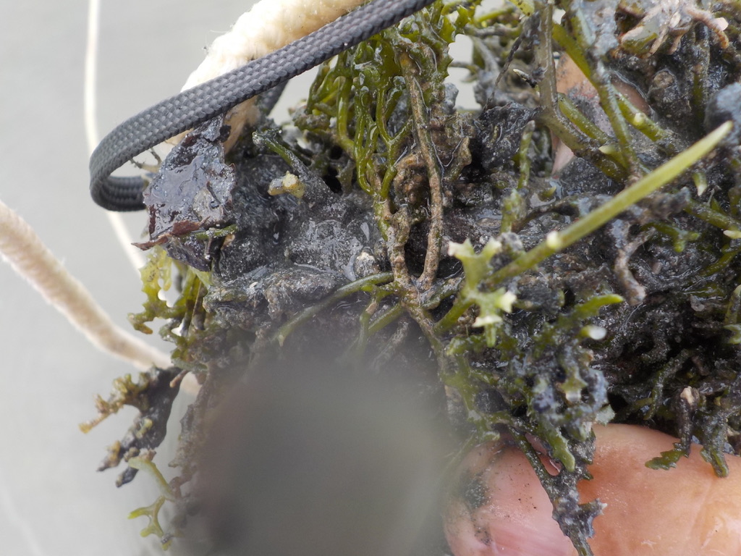
2018
2016
2021
GROWING CONCERNS OVER ALGAE IN THE PAST SEVEN YEARS…
Frequent Muri Community cleanups for beaches extended to lagoon algae in 2016, followed by Chamber of Commerce funded Steve Lyon Clean-up late 2016. Algae growth was tracked over this period, with photos, sampling and drone.
The problem has worsened with sedimentation caused by new heavier rainfall pattern since 2016 as confirmed by the Meteorology Dept. Sedimentation being trapped by algae resolving in shallower water as sedimentation/algae build up on the floor of the lagoon, resulting in warmer water and salinity.
Update: a pilot scheme was actioned in 2021 to clear growth and reduce sediment. We are tracking improvements in clearance and hopefully return of marine life driven away by benthos- (bottom) being unavailable for breeding and grazing.
Water surveys in 2021 confirm an extended purification cycle of 30yrs, 60 to +150 yrs from flat, hilly and mountain sources
Caulerpa Cuppressoides
White tips show sporing before dieback
Die Back and sedimentation in action.
Thick bed of algae
Dieback + sedimentation = thick black anoxic estuarine mud

Slide 14
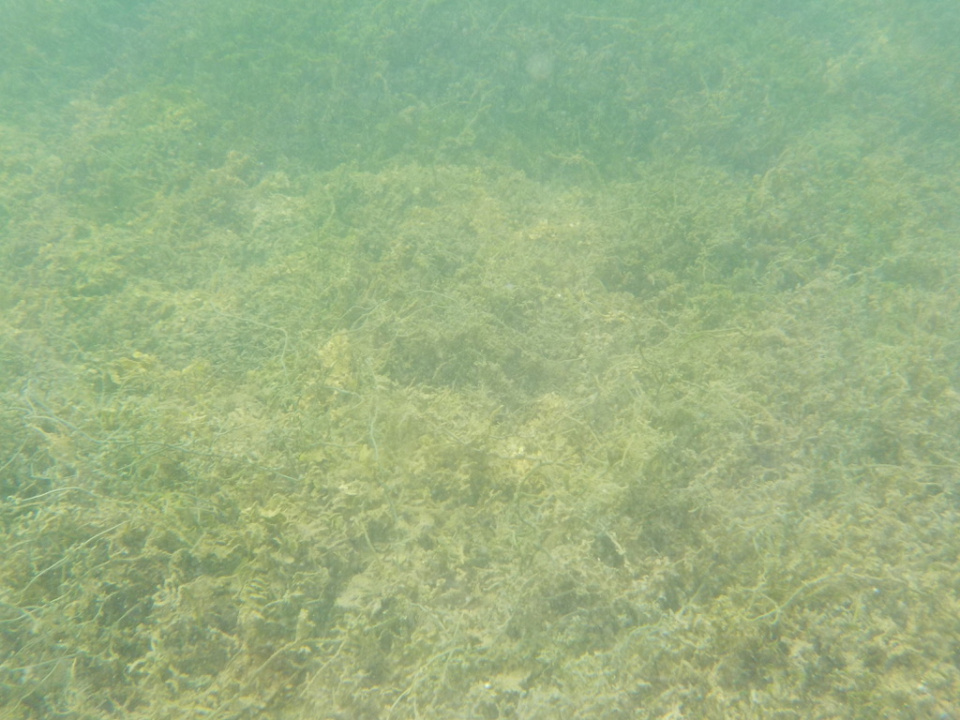
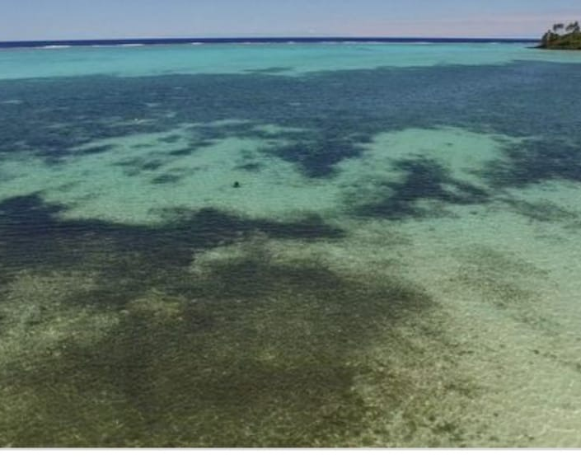
Streams are corridors for the sedimentation as we lose tonnes of valuable topsoil in heavy rains.
Topsoil lost from the land contribute to Algae growth
increase nitrogen and phosphates in the water
Topsoil takes over 100 years to form
Topsoil smothers coral and deprives it of light for growth
Coral turn white and die!!

Slide 15
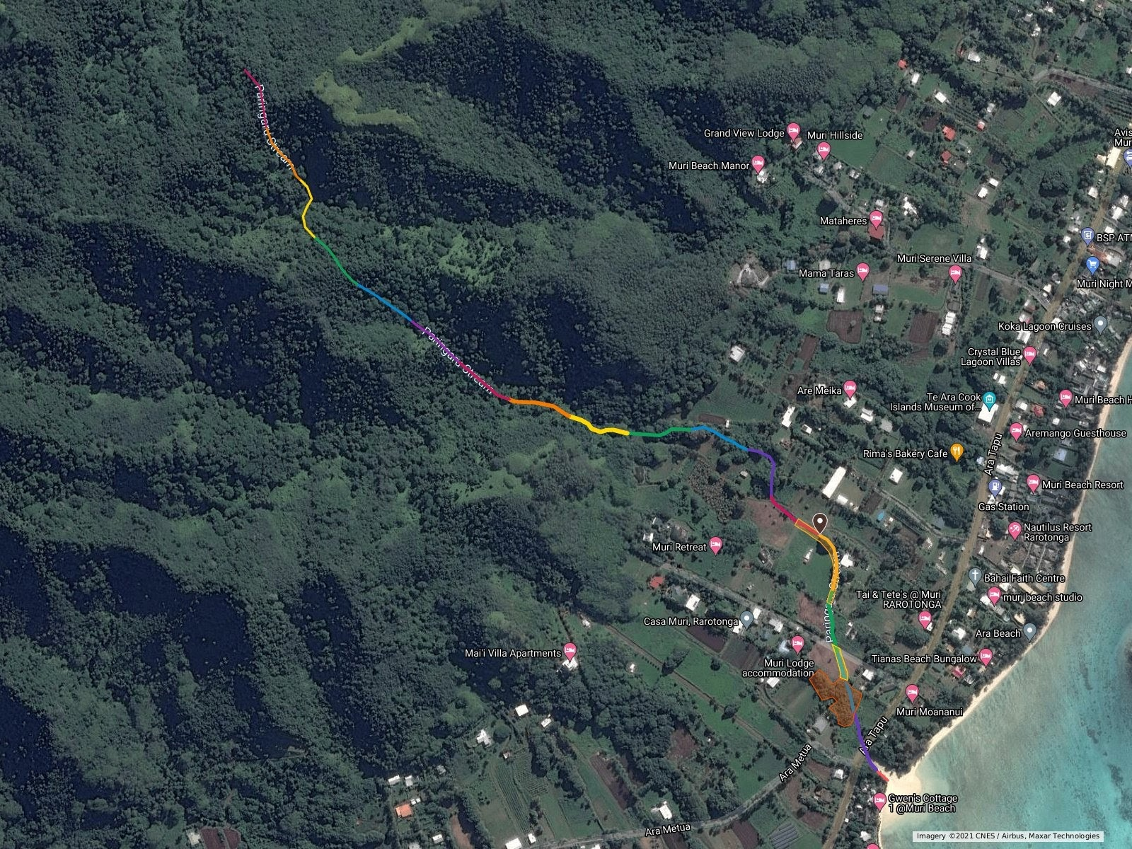
BELOW: Map of Muri streams – Parengaru, Areiti and Aremango…..
Above: Brennan’s detailed map for planting Parengaru Stream. Paired with photos recently taken at ground level, showing stream inclines, present planting and erosion.

Slide 16
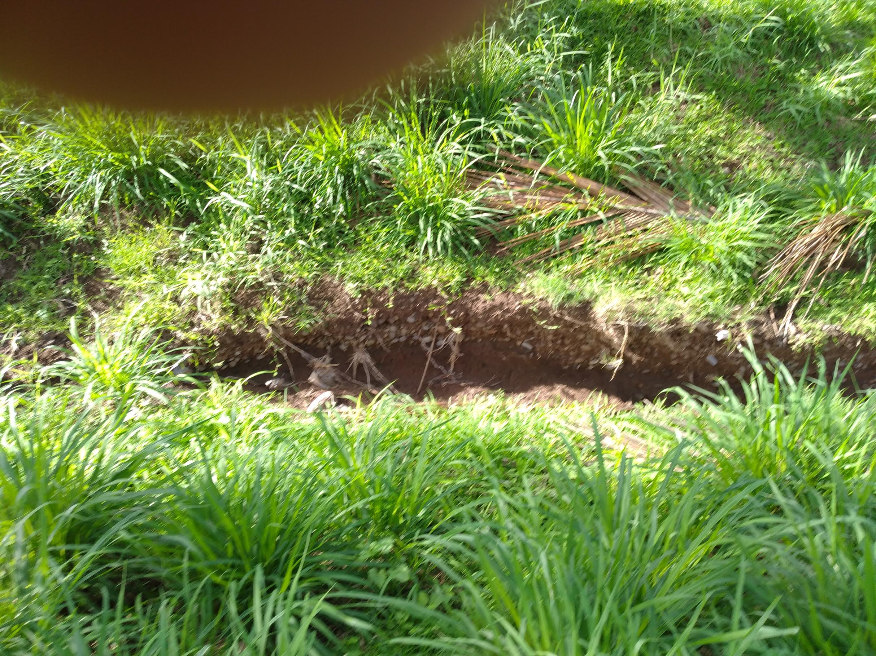
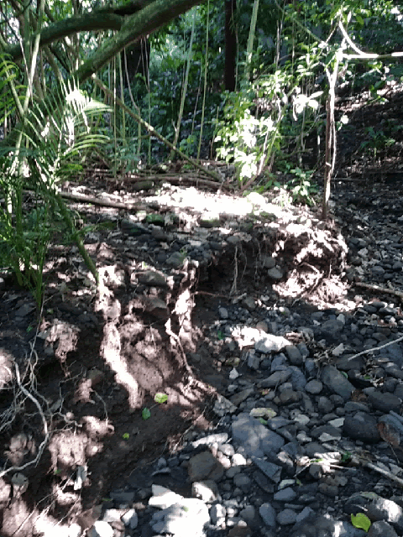
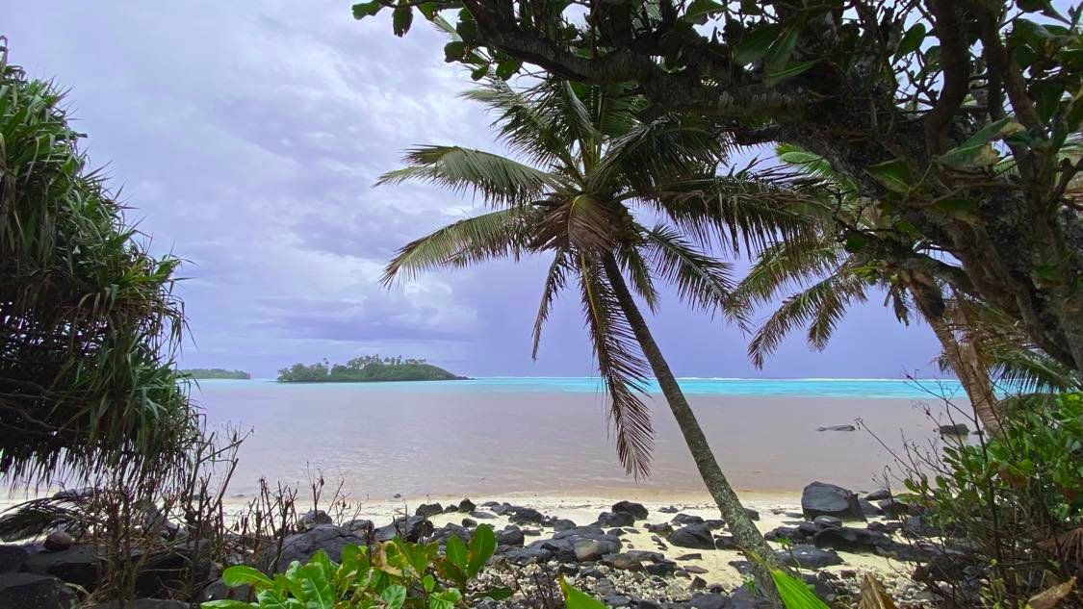
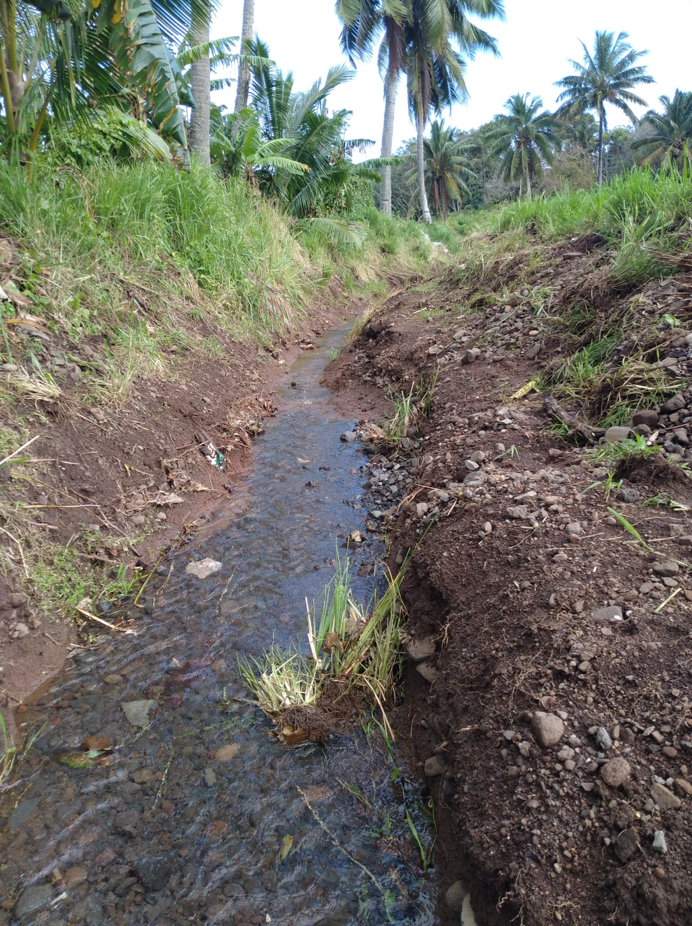
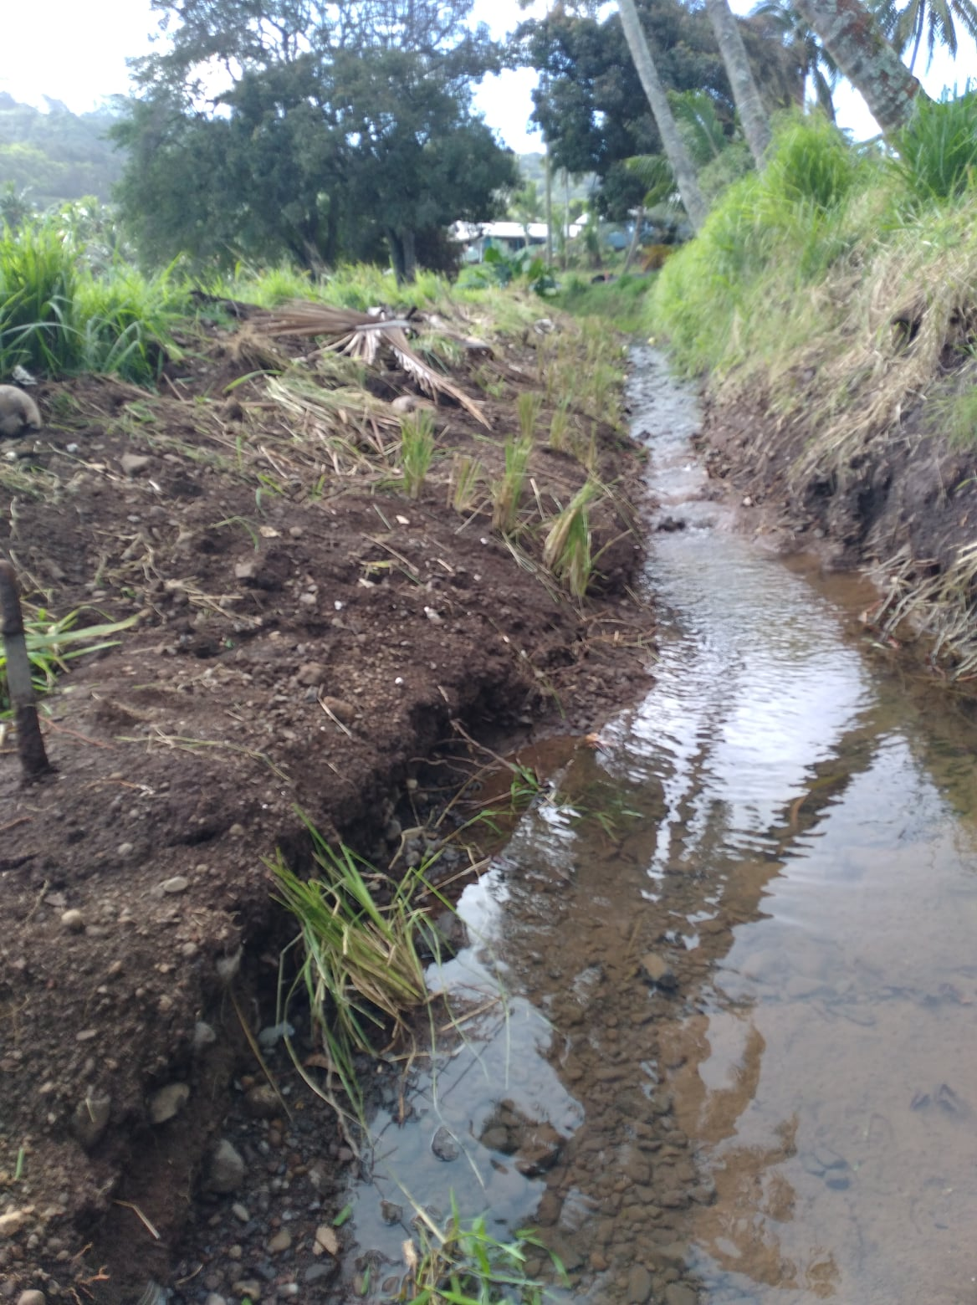
Left - Erosion on the flat and right -erosion on the hillside.
In heavy rain we take water samples to narrow down the problem areas.
PARENGARU STREAM MAY 2022
AUGUST 2022
AFTER SCRAPING

Slide 17
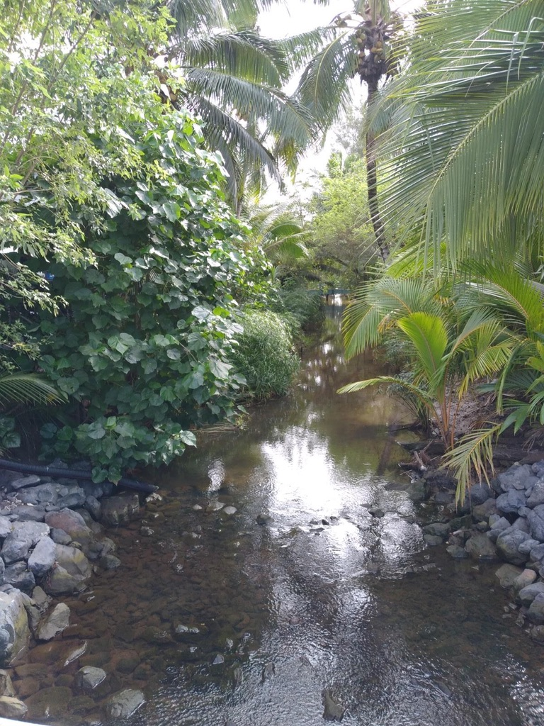
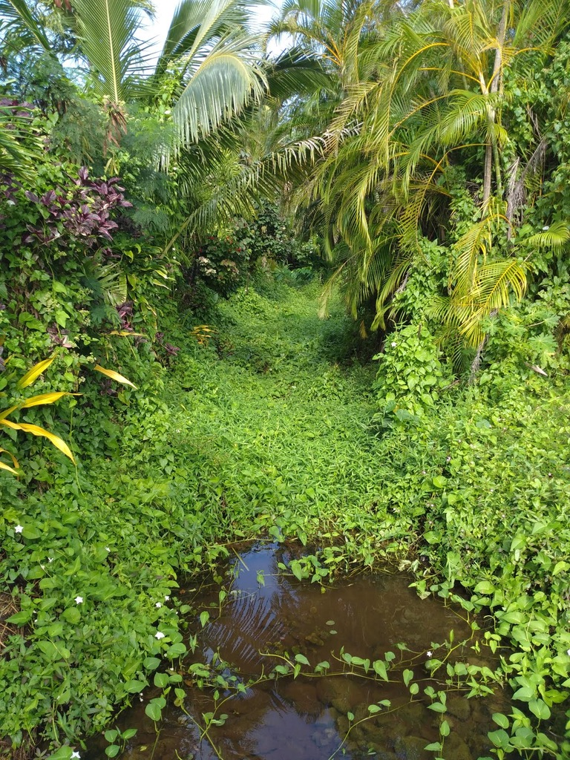
STREAMS PROJECT
See attached list of suitable plants. (List compiled by Brennan Panzarella and Takitumu Conservation native specialist) and Landowner community
Developed planting plans in consultation with Landowners to stabilize stream banks and methods to filter water through available wetlands before entering Muri lagoon.
Photos of bank inclines and stability for Parengaru, Are Mango and Areiti Streams as prepared for the community.
Plantings prioritise protection of marine and freshwater habitat for the future.
Eliminate invasives eg Ipomea Aquatica from Aremango and Areiti stream.
Collection of plants and nursery care for project, ex MEC nursery vetiver Agriculture Dept and Avana Vetiver over 6000 planted since July 2021.
Continuing research and advice on remediation…….in co-operation with Ministry Marine Resources and National Environment Service.
Flooded Aremango 2020
Ipomea aquatica
Aremango Stream
Invasive Ipomea Aquaitica, Aremango Stream
AREITI STREAM: Protecting marine and freshwater habitat for the future

Slide 18
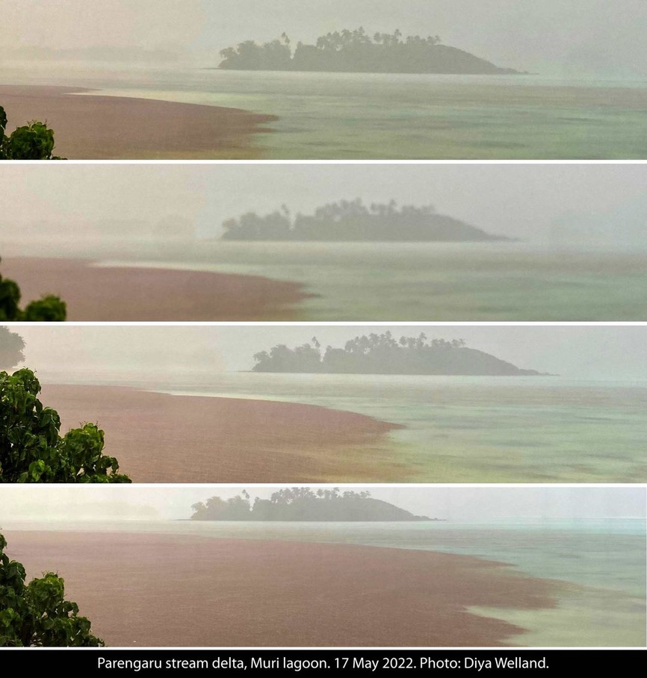
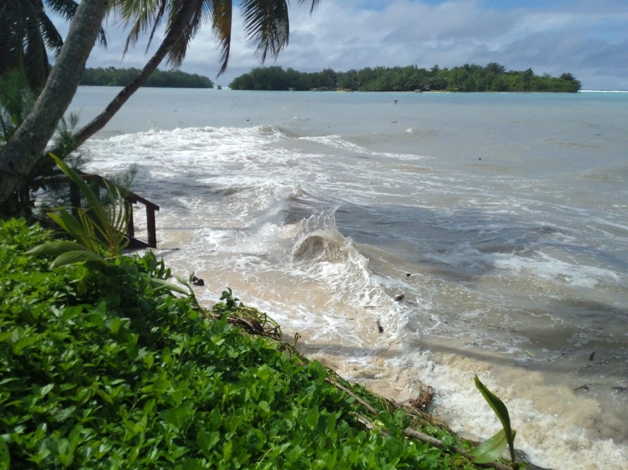
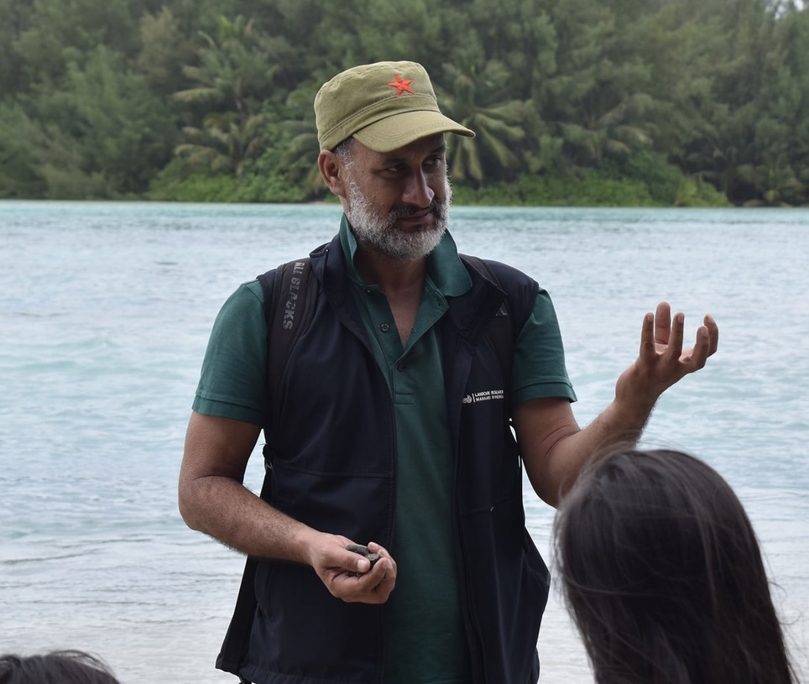
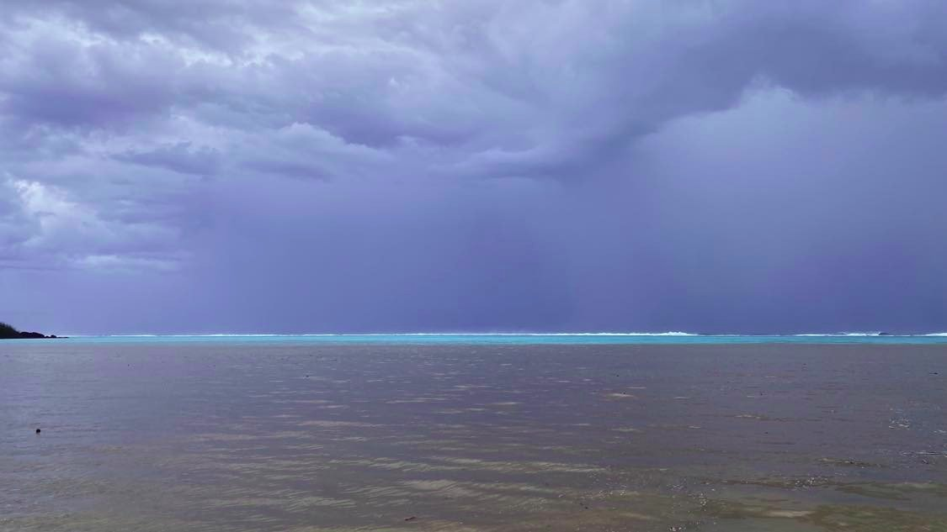
BEACH SEDIMENTATION/EROSION 2021/2022

Slide 19
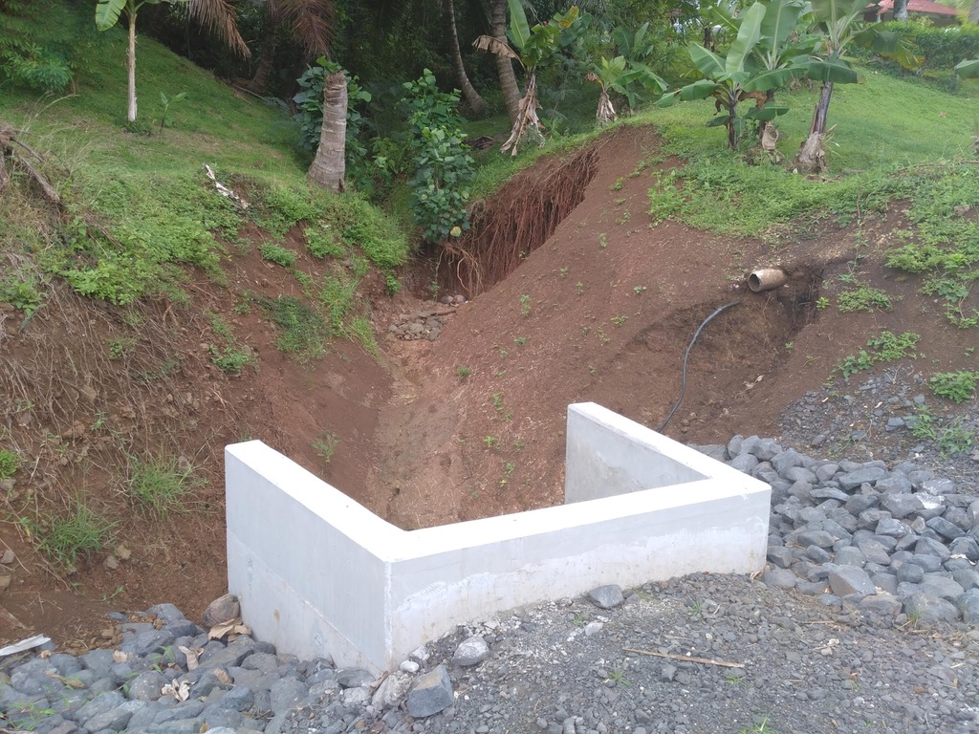
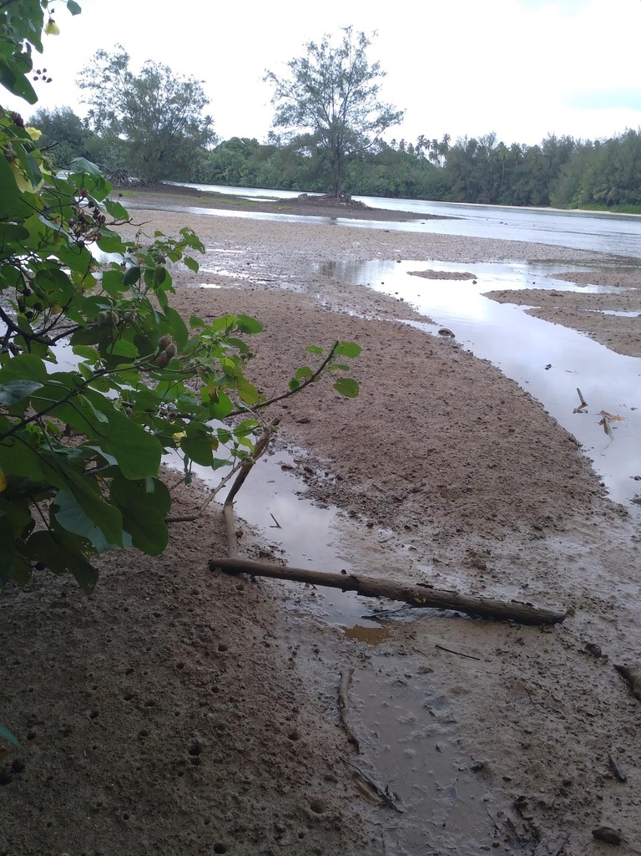
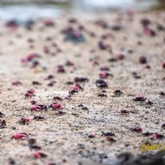
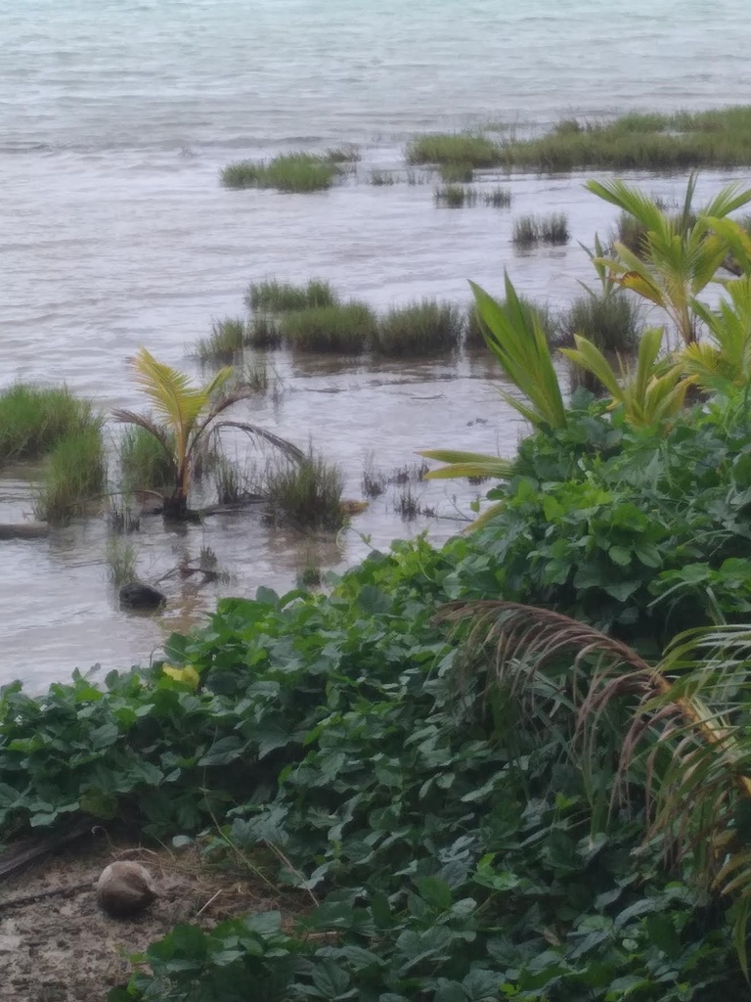
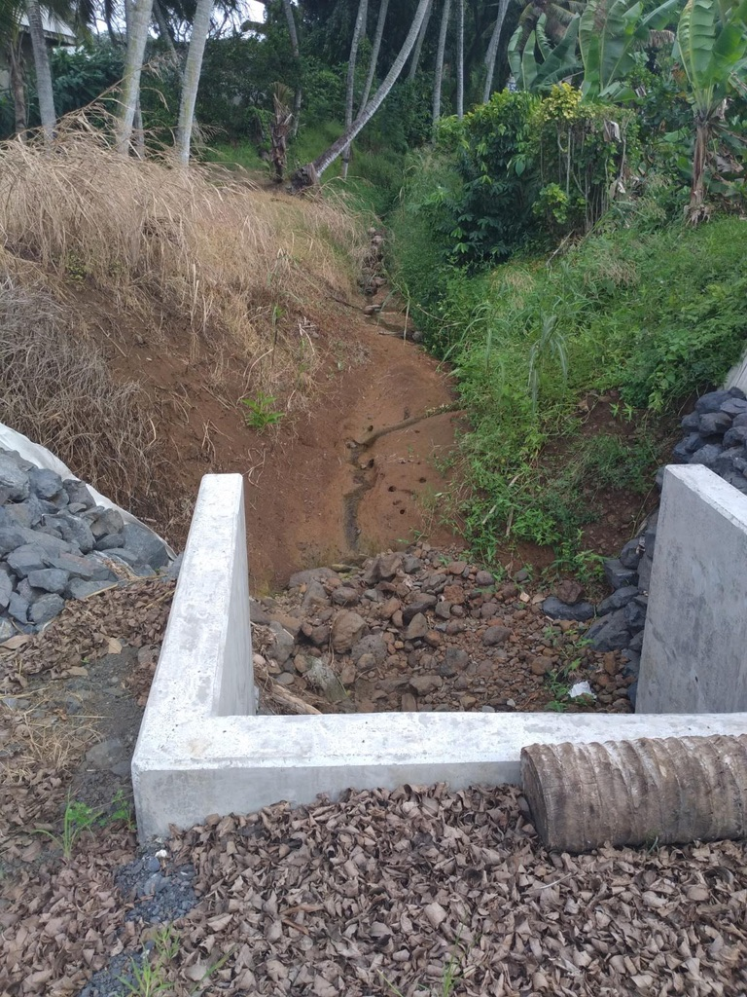
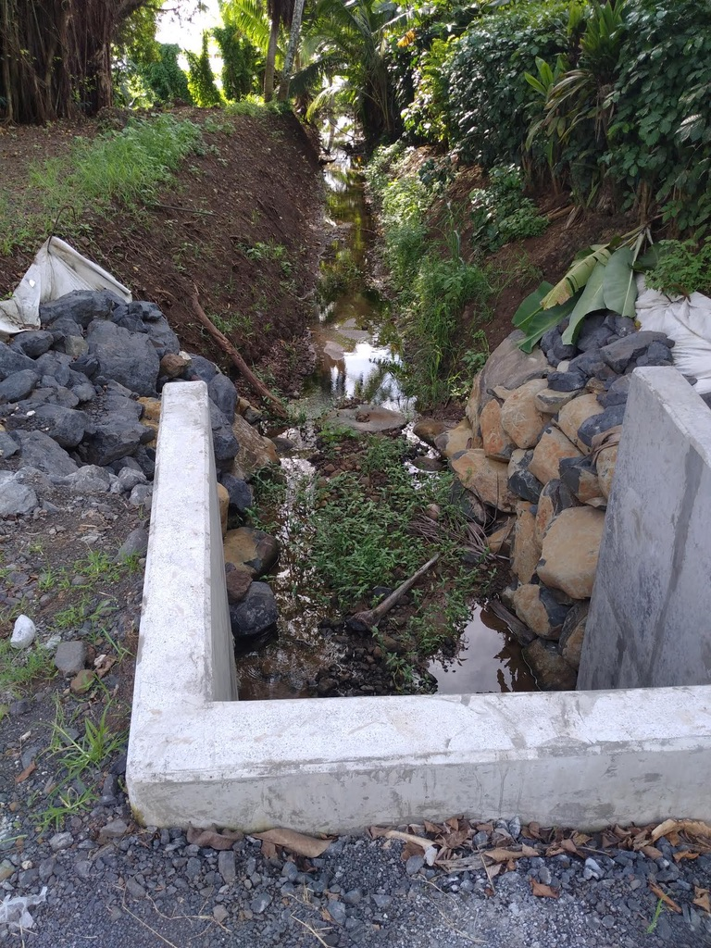
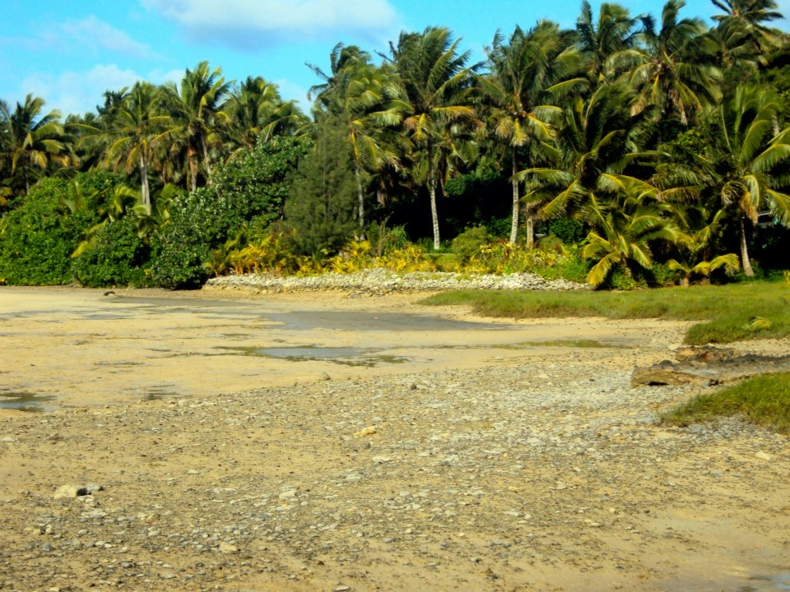
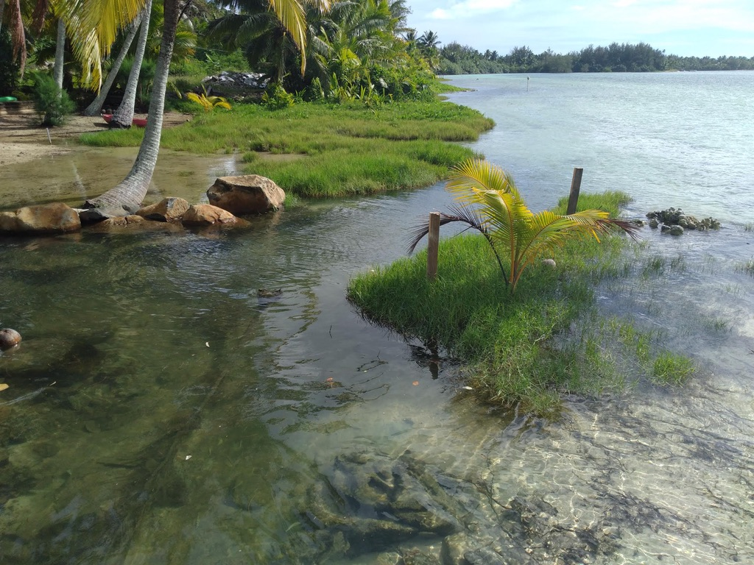
Aroko! A new threat to the Lagoon…..Flood culverts at Aroko, unfiltered muddy waters flows into Aroko flats threatening habitat for Koiti, crustaceans & seagrass nurseries for small fish & snails. Remedial engineering work recently re-started in this area on inland side of the road is essential to adopting best practice in its waterways design engineering

Slide 20
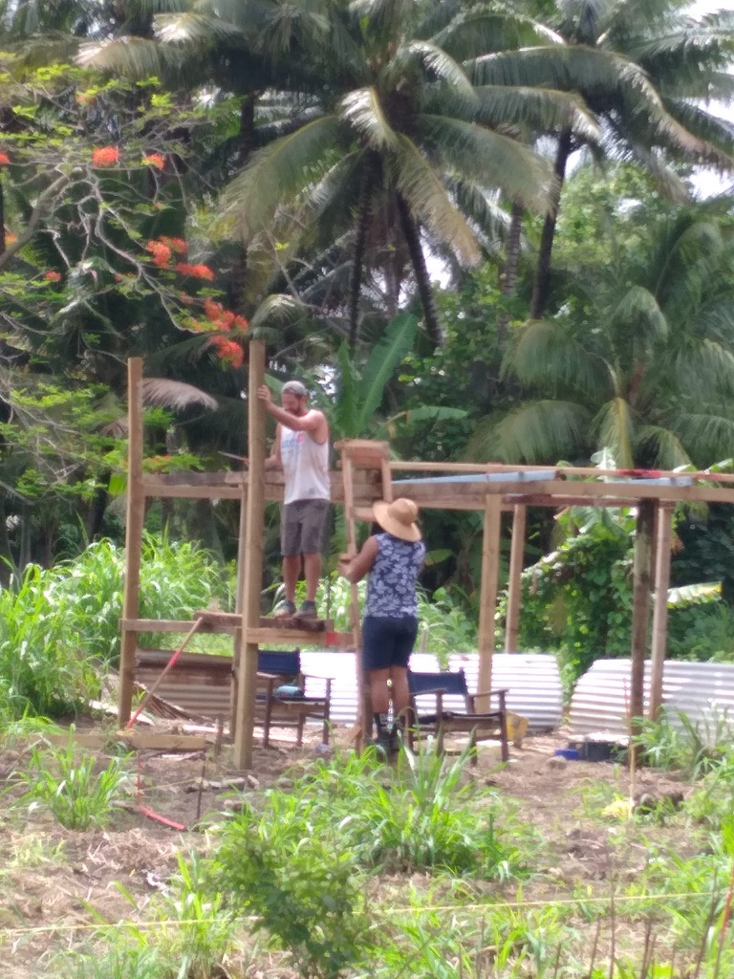
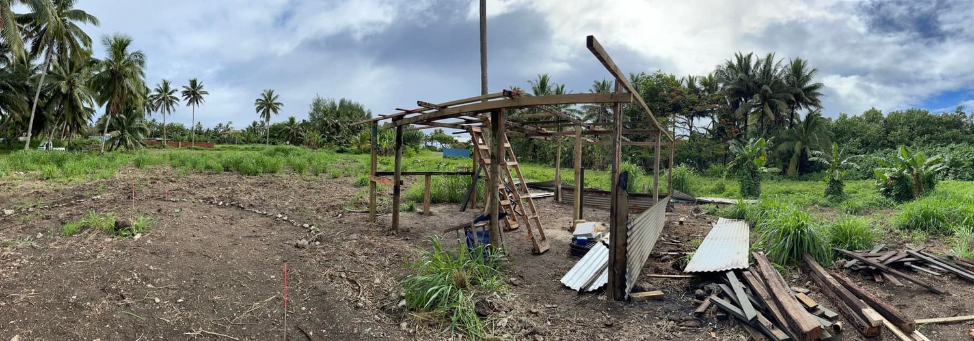
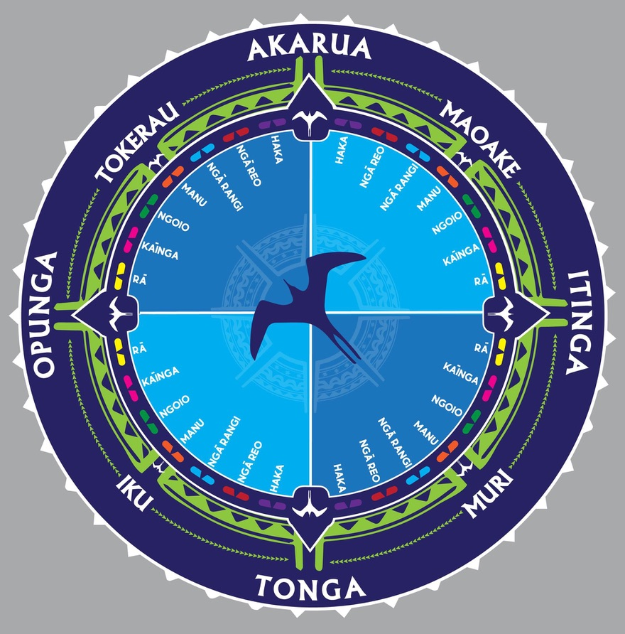
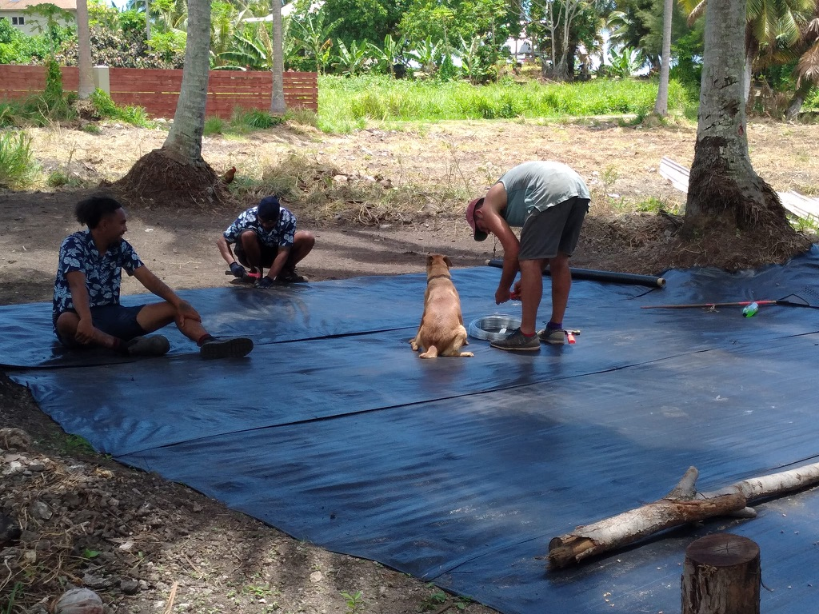
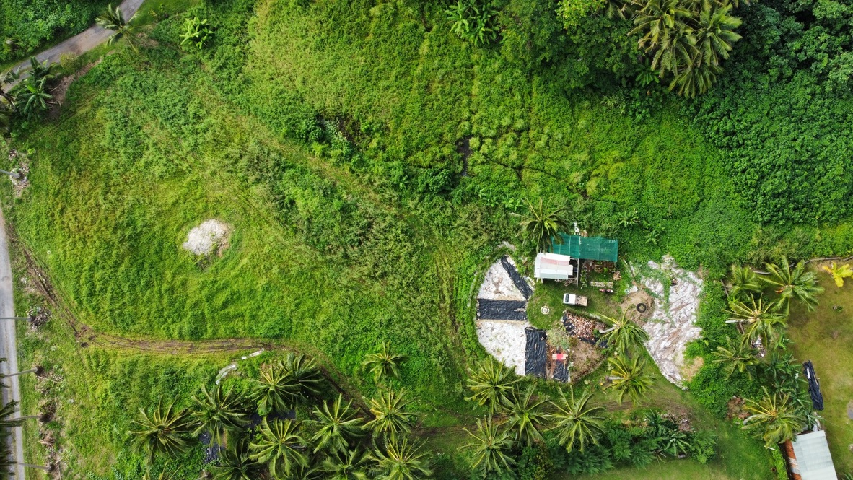
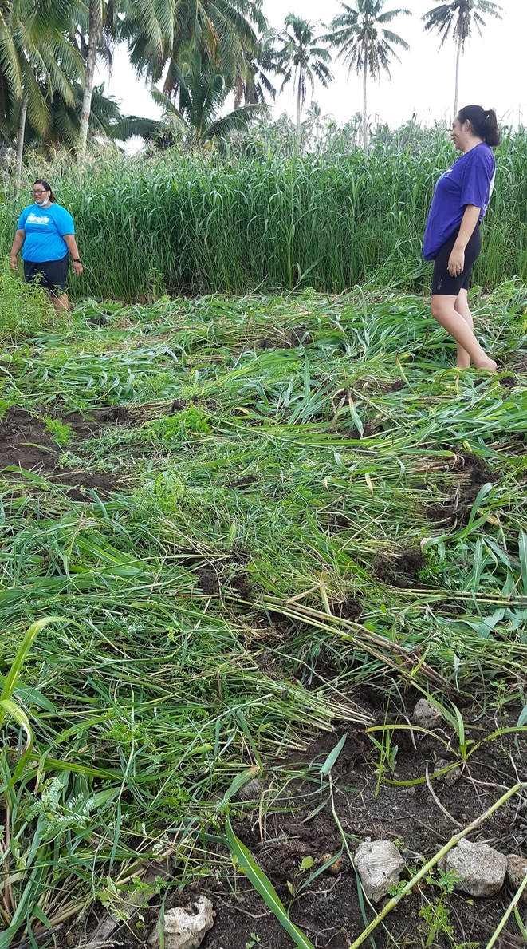
MEC NURSERY, PA ARIKI PALACE, EST. DEC 2021

Slide 21
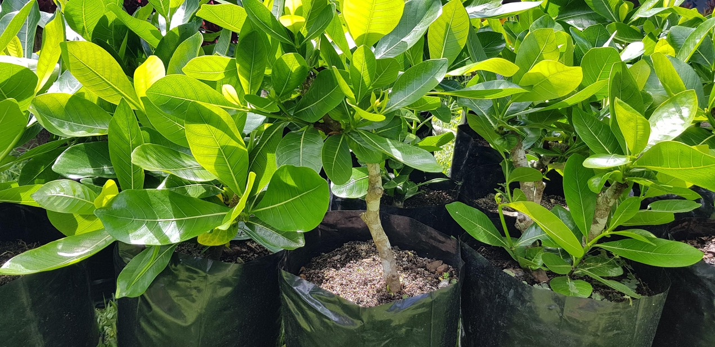
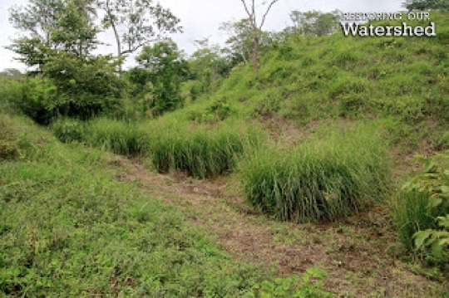
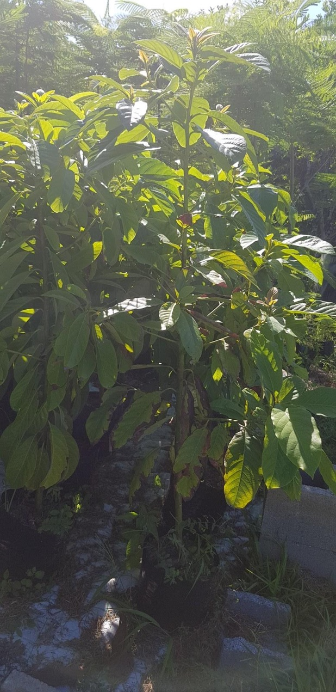
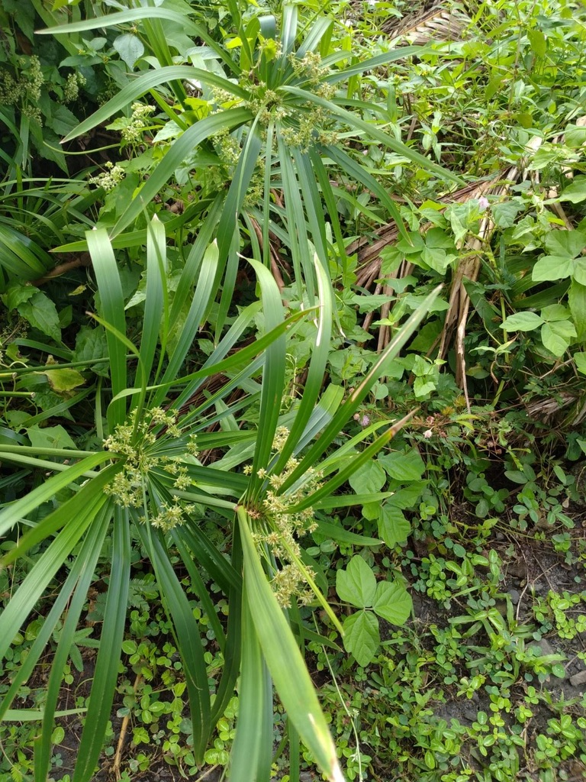
Stream Plants – a selection
FOR AREMANGO AND AREITI STREAMS - CYPERUS, SEAGRASS, TARO, VETIVER, MEDICINAL PLANTS, ORNAMENTALS AND FRUIT TREES. COMPLIMENT HOME GARDENS & RE-ESTABLISH WETLAND PLANTS TO INCREASE ABILITY TO FILTER SEDIMENT.
FOR PARENGARO –
SEAGRASS, VETIVER, ‘AU, CHESTNUT, MANGO, AVOCADO, NATIVE SPECIES
LANDOWNER SELECTION TO STABILISE BANK AT TOP
3 – 5M FROM TOP, SELECTION, PLANTING AND MAINTENANCE BY RESIDENTs.
PLANTS SUPPLIED AND ASSISTANCE TO PLANT FROM MEC.

Slide 22
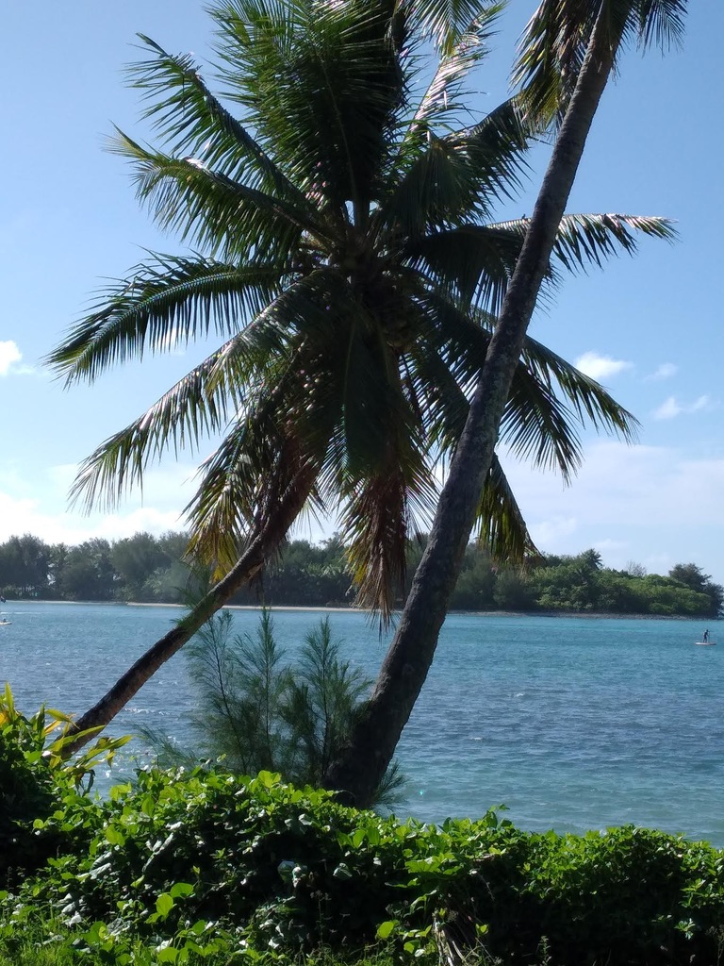
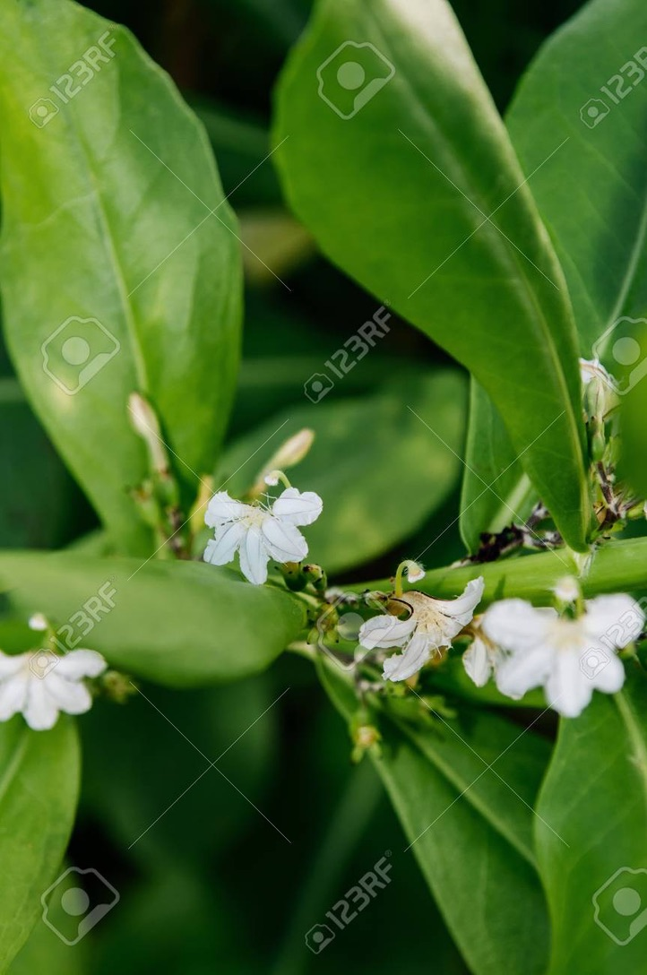
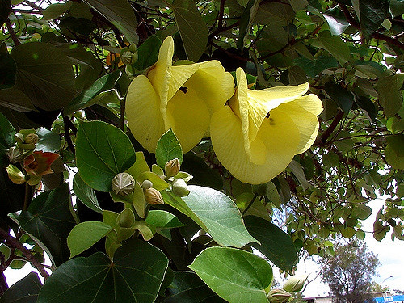
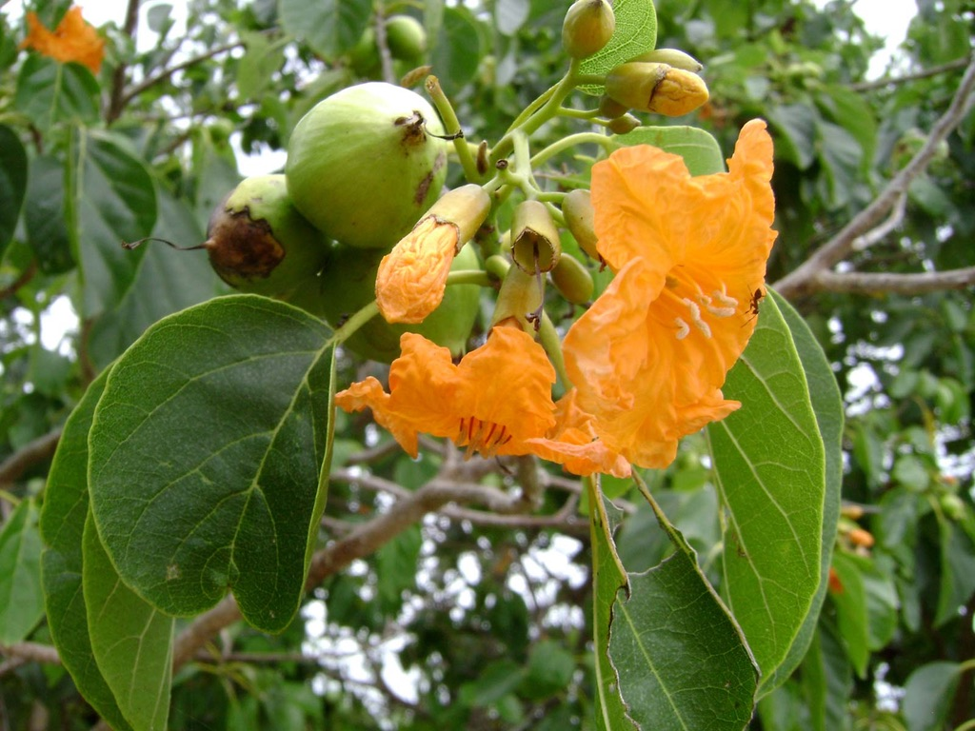
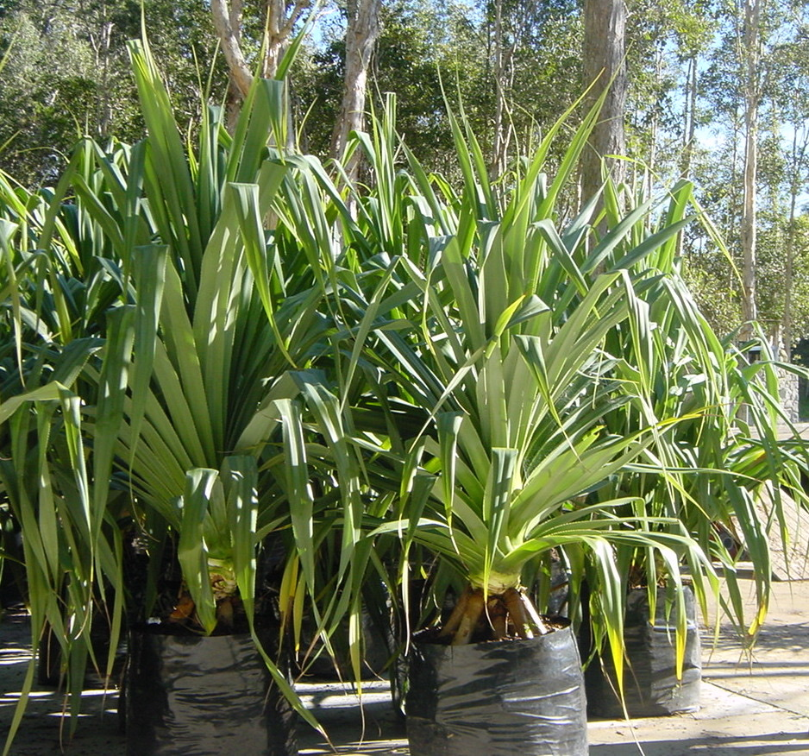
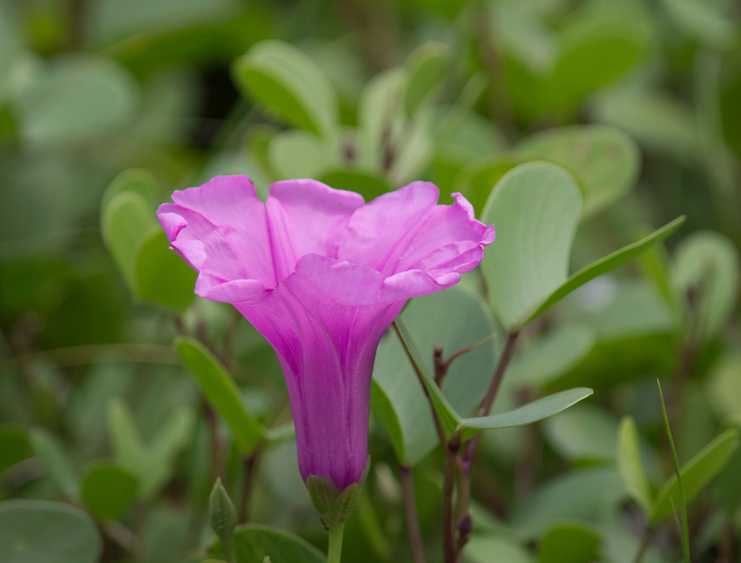
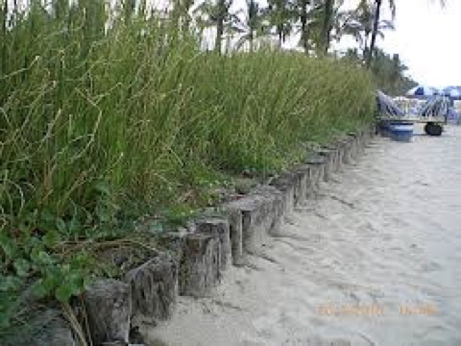
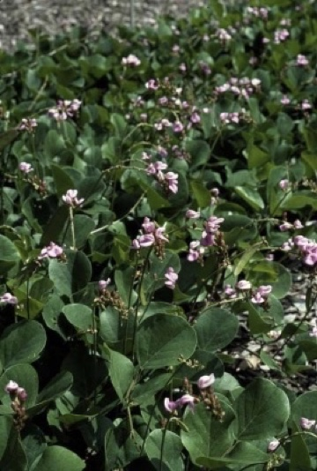
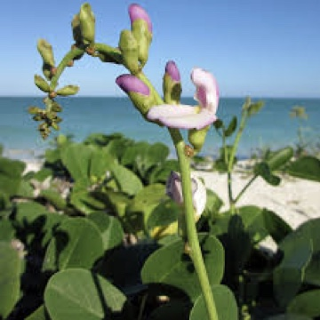
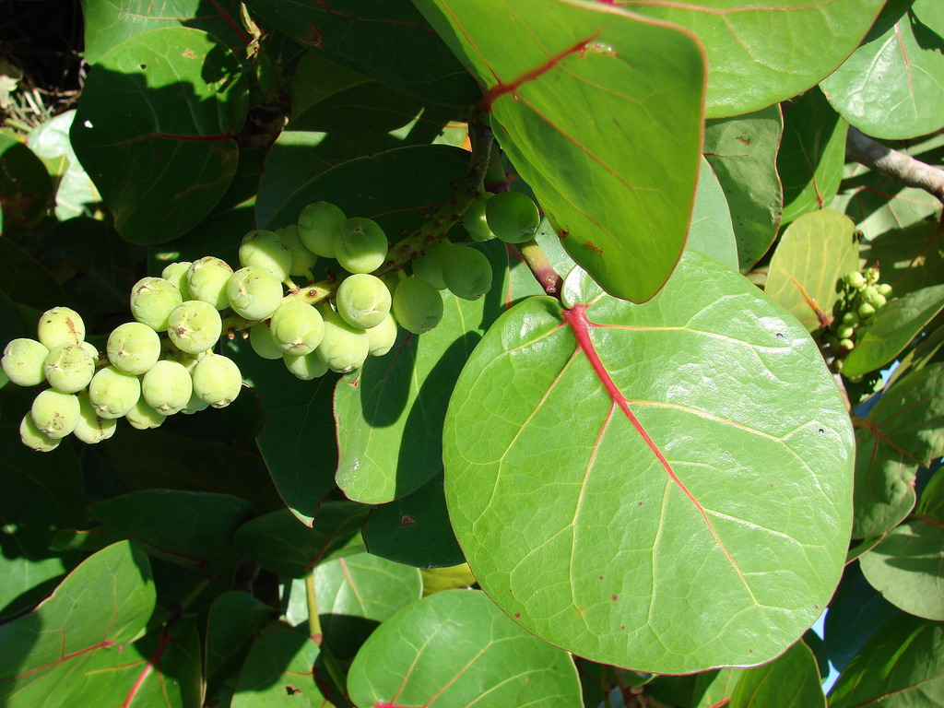
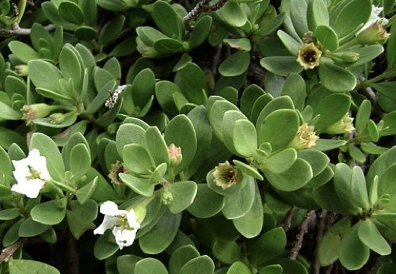
BEACH
PLANTS
Some other Plants
Ngangie
Tamanu
Candlenut etc

Slide 23
IN SUMMARY THE 2022 MEC GEF SMALL GRANT PROGRAM WILL Focus on Marine environment solutions Engage Aronga Mana, Landowners, Church groups, Village & School Communities Fund the Unfunded Volunteer Organisations to do the information, communication, training, mentoring in raising the knowledge about environments on land, in the valleys, on the hills, in the streams, waterways & lagoons, Preserving our soils, water, food supplies, our work, recreation, lifestyle, our residential homes, commercial businesses, farming practices, food production & our society
MEC Logo

Slide 24
IN SUMMARY THE 2022 MEC GEF SMALL GRANT PROGRAM.. MOU with UNOPS was signed by MEC on 11August 2022 for UNOPS New York Office. Drawdowns will flow direct to MEC Bank of South Pacific Account by September 2022 USD25,000; March 2023 USD20,000 upon interim reporting and September 2023 USD5,000 upon submission of the final report THE PROGRAM EXPENDITURE BUDGET IS
MEC LOGO
GEF Small Grant Programme | $37,870.00 | $34,660.00 | $72,530.00
Other co-financiers | $7,880.00 | $7,040.00 | $14,920.00
Total Other Income | $45,750.00 | $41,700.00 | $87,450.00
Less Operating Expenses
Contracts (Co-Financing) | $7,880.00 | $7,040.00 | $14,920.00
Equipment/Materials | $12,220.00 | $6,100.00 | $18,320.00
GEF SPG Personnel/Labour | $7,800.00 | $18,360.00 | $26,160.00
Other support requested | $17,600.00 | $9,400.00 | $27,000.00
Training /Seminars / Travel Workshops | $250.00 | $800.00 | $1,050.00
Total Operating Expenses | $45,750.00 | $41,700.00 | $87,450.00
Total Expenses | $45,750.00 | $41,700.00 | $87,450.00
Net Profit | $0.00 | $0.00 | $0.00

Slide 25
List of Muri Native Trees & Protected Species Compiled by Brennan Panzarella and Takitumu Conservation Trust, native specialist
List compiled by Brennan Panzarella and Takitumu Conservation Trust, native specialist

Slide 26
MEC PHOTO LIBRARY…..

Slide 27
List of Muri Native Birds & Species Compiled by Brennan Panzarella and Takitumu Conservation Trust, All lists have been complied with the assistance of Cook Islands National Heritage Trust - many thanks to Joe Brider and Gerald McCormack and Advice from staff of MMR and NES

Slide 28
Meitaki Maata

Slide 29
Engaged Brennan Panzarella, who has kindly to date volunteered his time and is planning plantings for the streams and waterways Brennan previously worked for Department of Conservation in NZ, and is contracted by MEC to manage this Ecology Project We are taking photo records of sediment pollution, erosion, bank inclines, undercut areas, plants & tree populations along the full extent of the streams This data enables preparation of the riparian planting, selection of plant & tree, plus location mapping for all species The selected of planting materials are being identified, listed and arrangements to propagate these plants are underway Schedule includes seagrass, taro, waterlillies, medicinal native species, chestnut, mango, fruit trees, Puka & other shade native species.
MEC LOGO

Slide 30
Context of this MEC update of 14TH JULY 2021 MEC APPLICATION INITIALLY SUBMITTED ON THE 14TH April 2021 and since then we have;- Exchanging technical info & pic-lagoon data with Dr Matt Blacka, University of NSW Working with Matt re options for streams, waterways & lagoon Understanding longer term sea level rising statistics and interpreting scientific impacts into our Waterways more detailed planning before outlining our delivery strategies. Observed and attended briefing meetings, assisted with planning of the Muri Lagoon management Pilot project, supported environmental practices, Identified small sample area of the lagoon; team has commenced the mechanical racking, dislodging of algae weed, hand removal of weeds and sediments. Overview of the weed and sludge material, checking the care being exercised to not disturb ecosystems and marine life in their natural habitat
MEC UPDATE

Slide 31
Accessing and working in various nursey sites, preparing for and managing the acquisition of plant materials. Receiving 1,500+ potted vetiver plants from Ministry of Agriculture, setting out, maintaining water & their growth Planning the media materials for the preparation of workbooks, guide to the care and maintenance of Stream & Waterways, colour posters printed material, photo record and publicity materials. The briefing, information & communication plan for the stream beds & waterways landowners, identifying the homes along the streams Scoping the interaction with community meetings, school groups, church groups, commercial businesses Sorting out digital online materials for posting to social media and website
MEC UPDATE

